Slide 1


Automating Testing with CORA Code GenY
June 2024

Slide 2
Background and Opportunity - USAA
The USAA Team is looking for an opportunity to establish a strong Quality Engineering via CORA CODE GENY Orchestration Engine to uphold and standardized Quality Engineering Services to deliver end to end solutions. Test Data Management solution framework, Standardization in Regression framework,
Generate synthetic test data on demand and automate test data generation
Accelerated Regression Quality Engineering and end to end development
Deliver innovation around reducing workload, (e.g., process improvement, automation, standardizations)
Challenges | Accelerator | Solution
Data Planning, Data Virtualization, Data Generation & Provisioning | Synthetic Test Data Generator | DaQuery generates Synthetic test data specific to Domain specifically for testing purposes in JSON,XML or CSV file format. Synthetic test data helps assess the performance, functionality, and reliability of software applications or systems without using actual production data,
Whenever automation testing needs to be run, the test data / test scripts has to be created manually. | Test Script Generator | Empowering seamless automation script generation directly from feature files, revolutionizing testing frameworks with unparalleled efficiency and precision
Lack of data automation and repeatable process makes this labor intensive. | User Story Generator | Transforming business requirements into user stories effortlessly through automated processes, delivering innovation with efficiency.
Notes:
Update – the Challenges on the
Current Approach
GenY Solution
How we will implement Geny to Address Current one area - POV
How we can Deliver in the future – Roadmap
Recommendations –
PreRequite
Team – Responsibility – Count

Slide 3
CORA Code GenY to drive efficiency across the different phases of SDLC
CodeGenY is a unique accelerator that leverages the power of generative AI and LLMs to help software developers and engineers create high-quality code, documentation, and infrastructure in a fast and secure way. CodeGenY is designed to address the challenges of using LLMs in a production environment, such as data privacy, policy compliance, and auditability.
Utilizing CORA Code GenY accelerator can streamline processes and significantly reduce the effort of Quality Engineering by 30% - 40%
Synthetic Data Generator
IDE Plugin for Code Generation
User Story Generator
Test Script Generator –
Cora CodeGenY
Terraform Code Generator
Code Optimizer
Code Documenter
AI Based Code Review Plugin
Code Complexity Calculator
Code Analyzer & Documenter

Slide 4
Benefit % - USAA Pre and Post CORA Code GENY
Competency | Dimensions | Average Current State Efforts per medium sized User Story | Approximate- Potential Efforts required by adopting CCGY | Productivity Gain %
Requirements/BA Efforts | Requirements Documentation | 8hr (1 point) | 3-5 hr | 30%-50%
 | Requirements Sign-Off
 | Jira Story creation
 | Jira Task Creation
Dev | Code Generation & Implementation | 16 hrs (2 Points) | 12-14 hrs | 20-25%
 | Code Review | 4hrs (1 Points) | 1-2 hrs | 30-40%
 | Unit Test Case Generation (Gunit)
Test/QA (Manual) | Req. Analysis & Clarifications | 8hr (1 Point) | 4-5hrs | 30- 40%
 | Test Design (Scenarios + Test Cases + Reviews)
 | Test data Creation/Identification
 | Test Execution

Slide 5

Detailed Plan for POC
2 weeks
8 weeks
2 weeks
Initiation
Sandbox & POC
Roadmap Strategy
Access setup
Design & Project plan
Define data privacy, security and other key risks
Alignment with organization goals
Milestone 1
Milestone 2
Milestone 3
Milestone 4
Setup of CORA Code GenY in USAA sandbox
Access to key team members
Testing & Report Out
Setup of CORA CodeGenY to execute the QA process
Integrate with the toolchain for code commit
Report out on current efficiency of QA process vs process enabled by CORA CodeGenY
Future State Recommendation
Operating Model
Skill Gap & Strategy
Implementation Roadmap
Define current state Initiate access request Articulate objectives Identify specific areas or processes where CORA CodeGenY will be expected to enhance efficiency Stakeholder alignment Risk Assessment Resource Allocation Project Plan | CORA Code GenY Setup Identify dependencies Access to lower environments Open AI / LLM setup Development & deployment Testing Data collection & preparation | Integration with existing toolchain Data collection & preparation Tool selection Environment Setup Access Provisioning Use Case execution Testing | Metrics & Outcomes Measure efficiency and outcomes Feedback collection Report out and documentation preparation Training & Org Readiness Integration Plan Report Out | Roadmap & Strategy to Scale Demo & Feedback Sandbox & access provisioning Metrics Future State & Recommendation Implementation Plan
5
© 2021 Copyright Genpact. All Rights Reserved.

Slide 6
Detailed Plan – End to End RoadMap
2 weeks
8 weeks
2 weeks
Initiation
Sandbox & POC
Roadmap Strategy
Access setup
Design & Project plan
Define data privacy, security and other key risks
Alignment with organization goals
Milestone 1
Milestone 2
Milestone 3
Milestone 4
Setup of CORA Code GenY in USAA sandbox
Access to key team members
Testing & Report Out
Setup of CORA CodeGenY to execute the QA process
Integrate with the toolchain for code commit
Report out on current efficiency of QA process vs process enabled by CORA CodeGenY
Future State Recommendation
Operating Model
Skill Gap & Strategy
Implementation Roadmap
Define current state Initiate access request Articulate objectives Identify specific areas or processes where CORA CodeGenY will be expected to enhance efficiency Stakeholder alignment Risk Assessment Resource Allocation Project Plan | CORA Code GenY Setup Identify dependencies Access to lower environments Open AI / LLM setup Development & deployment Testing Data collection & preparation | Integration with existing toolchain Data collection & preparation Tool selection Environment Setup Access Provisioning Use Case execution Testing | Metrics & Outcomes Measure efficiency and outcomes Feedback collection Report out and documentation preparation Training & Org Readiness Integration Plan Report Out | Roadmap & Strategy to Scale Demo & Feedback Sandbox & access provisioning Metrics Future State & Recommendation Implementation Plan
6
© 2021 Copyright Genpact. All Rights Reserved.

Slide 7
Key metrics to be measured During POC for Identified Scenarios
Area | Metric | Description
User Story Creation | Cycle Time | Track the time taken to complete a user story from creation to deployment. It helps identify bottlenecks and streamline the process
User Story Creation | Backlog Health | Assess the state of the backlog, ensuring that it is well-groomed, prioritized, and contains clear, detailed user stories
User Story Creation | Story acceptance rate | Percentage of stories accepted by the development team without needing clarification or rework
User Story Creation | Number of Revisions | Track how many times a user story goes through revisions. High revision rates may indicate unclear requirements
Build | Code Churn | Measure the frequency and extent of changes made to the codebase. High churn may indicate instability or frequent changes in requirements
Build | Code Review Metrics: | Track the time taken for code reviews, the number of comments, and the resolution time. Efficient code reviews contribute to higher code quality.
Build | Release velocity | Number of stories or features completed per sprint or release cycle
QA | Code Coverage | Evaluate the percentage of code covered by automated tests. Higher code coverage indicates a more thoroughly tested codebase.
QA | Defect Density | Measure the number of defects identified per unit of code. A decreasing defect density over time indicates improving code quality.
QA | Test Coverage | Assess the percentage of requirements covered by test cases. Higher test coverage ensures a more comprehensive validation of the system
QA | Escaped Defects | Track the number of defects that make it to production. A decrease in escaped defects indicates improved QA effectiveness
Project Metrics | Release Burndown | Monitor the progress of work towards completing a release or project. It helps in identifying potential delays and adjusting plans accordingly.
Project Metrics | Customer Satisfaction | Collect feedback from end-users to measure their satisfaction with the product. Positive feedback indicates successful delivery and meeting user expectations.
* Assessment phase to determine, which metrics are applicable for the agreed use case

Slide 8



Team Formation & Commercials - Sandbox
USAA + Genpact Steering Committee
USAA Sponsor
Genpact Sponsor
Point of Contact
Duration: 12 wks
Cora GenY +
Services
Cloud Architect
IT Leader
Security Architect
Guidewire Tech Architect (1)
CORA Code GenY- Architect
USAA Team
Developers (2)
Genpact Team
Sandbox

Slide 9
CORA Code GenY : Proposal Constructs
GenAI – Sandbox in USAA Environment
Setup
Training
PoC
Capacity Service Model
New Develop - Staff Augmentation
Support for GenAI in SDLC
On-going Training
License Agreement – Intent to protect:
Protect IP
Ability to recoup fees if Services Contract is terminated
Provide support and enhancements to IP over the course of engagement with the client
Limit the use of IP to Genpact and Client ONLY! – No 3rd party system providers or integrators

Slide 10


BDD (Behavior-Driven Development) Test Scenarios Creation Using GenAI – Case Study
Genpact’s SDLC solution for an American investment company
Industry
ServiceLine
BCM
QA
Challenges
Our Solution
Impact
Manual test scenario creation. Writing BDD test scenarios manually is intensive and time-consuming, averaging 30 minutes per user story.
Heavy reliance on manual creation of BDD test scenarios, increasing chances of human error, longer testing cycles, and decreased productivity.
Lack of traceability and mapping: Absence of a seamless process to trace or map BDD scenarios to user stories in Jira, leading to potential discrepancies and inefficiencies.
Overloading the product team with the responsibility of writing functional test cases in BDD format for various application business requirements.
Utilizing Generative AI capabilities to create BDD Test Scenarios across various user stories.
Utilize Python Flask services hosted on a Private Cloud to integrate the Jira system with the client’s internal GenAI platform, ensuring the seamless creation of BDD Test Scenarios directly from the User story in Jira.
Mapping BDD scenarios with respective user stories and validating diverse test cases generated by the AI systems.
Automated BDD scenario creation and mapping against Jira stories have significantly reduced the Turnaround Time (TAT) for BDD scenario creation and mapping by approximately 35%.
Enhanced coverage of test cases across diverse scenarios ensures comprehensive testing across all test cases.
Improved traceability of test cases generated by Generative AI provides enhanced visibility for QA, Business Analysts, and Developers, ensuring comprehensive testing for each story.
Highly replicable use case for the client across verticals.

Slide 11
Generate Ansible Playbook Templates - Case study - Automation on Automation – A large European Investment company utilizing Genpact’s GenAI solution for accelerate the learning and mastery of Ansible
Industry
ServiceLine
BCM
Tech Services
Challenges
Our Solution
Impact
Manual provisioning challenges
Manual intervention leads to potential human errors.
The diverse nature of configurations makes it time time-consuming task.
Dynamic requirements and scale
Challenges in adapting to evolving requirements.
Inability to promptly accommodate changes affects the business's agility and responsiveness.
Time and resource constraints - High learning curve and lack of skilled and experienced talent.
Complexity in infrastructure management - Evolving infrastructure with multiple dependencies leads to inconsistent provisioning process.
Generative AI-powered playbook creation
Prompt engineering and code generation to reduce development time and effort.
Lowers entry barrier and enables the existing team to scale up.
Automated infrastructure orchestration
Standardized and centralized platform.
Seamless integration with config management tools.
Enable dynamic infrastructure scaling - Automated adjustments to infrastructure configurations based on demand and load.
Continuous integration and deployment - Facilitate version control and automation by integrating with CI/CD pipelines.
Efficiency gains and time savings
Significantly reduced operation time by 42% from 420 minutes to 180 minutes.
Improved responsiveness of the IT Team.
Consistency and standardization
Standardized deployments across environments.
Reduced TAT for troubleshooting issues.
Improved scalability, agility, and quality
Manages increased workloads without a proportional increase in team size.
Optimized resource utilization, allowing teams to focus on strategic tasks.
Reduced errors associated with manual interventions.

Slide 12


Thank you

Slide 13
Factors Driving Application Development
Prioritization
Requirement Gathering
Project Plan
Prioritization
Requirement Gathering
Project Plan
Environment Configuration
Deployment Automation
Rollback Strategy
Security Compliance
Artifact Management
Communication & Collaboration
Requirement walkthrough
Requirement Analysis
Initiation
DEPLOY
Planning
RELEASE
Current
OPERATE
Future
Code Review
Testing Automation
Bug detection & remediation
Code version control
Release management
BUILD
Monitoring & Alerting
Incident management
Root cause analysis
User Support
Compliance & Reporting
TEST
Test
Incident Detection
Reporting
Resource Optimization
Log analysis & management
Test Case Generation
Test Data Generation
Test Automation
Coverage analysis
NFR Testing
Rumor driven development
Cognitive overload
Lack of automation
Repetitive mundane manual steps

Slide 14
CORA Code GenY accelerators to address these challenges.
Legacy Code Analyzer
QA Accelerator
Data Model Documenter
Code Converter
Read and comprehend legacy code, making it easier to understand the codebase's structure and functionality
Extract key insights and summarize the critical aspects of the legacy code, such as its main functions, dependencies, and potential areas for improvement
Generate test cases to streamline the testing process for legacy systems & reduce the risk of introducing errors during modernization or maintenance efforts
Can generate Behavior-Driven Development (BDD) test cases, test scripts that cover critical scenarios
Parses Database Definition Language (DDL) scripts, extracting relevant details and generating comprehensive documentation aligned with Domain Driven Design principles, streamlining the understanding of data structures , relationships, domains and sub-domains
Effortlessly transform code between languages and frameworks with AI-powered plugins, saving time and streamlining workflows.
Intelligently interprets syntax and semantics, facilitating seamless translation and migration of code across diverse platforms
IDE Plugin
Cloud Native Patterns
Synthetic Data Generator
IaC Generator
AI-driven suggestions and code completions for smoother, more efficient coding experiences
Receive context-aware recommendations tailored to your specific project, reducing errors and boosting productivity.
Repository of cloud-native patterns which serves as a valuable knowledge hub, offering developers proven and optimized solutions for common challenges
Reusable, battle-tested design principles and best practices, fostering consistency
Synthetic data generator which provides realistic and privacy-compliant data sets, enabling efficient testing and development without exposing sensitive information
Mimics the characteristics of real data, facilitating faster iteration cycles, reducing dependencies on live data
AI based plugin which automates the generation of IaC, enabling rapid provisioning & configuration of cloud resources
Analyses project requirements and architectural patterns, providing intelligent suggestions and code snippets

Slide 15
Deployment Model
Data
Data/Document source
Data pipeline
GenAI Models
Vector database
Playground & Demo Application
AI playgrounds
CORA Code GenY
Orchestration
APIs
Demo applications
Plugins
Applications
LLM APIS & Hosting
Enterprise Applications
Application hosting (Apls, Plugins, custom apps)
LLM Cache
Custom
Proprietary models
Open AI Models
Logging
Cloud provider models
Other Third party GenAI Tools
Policy Guardrails

Slide 16
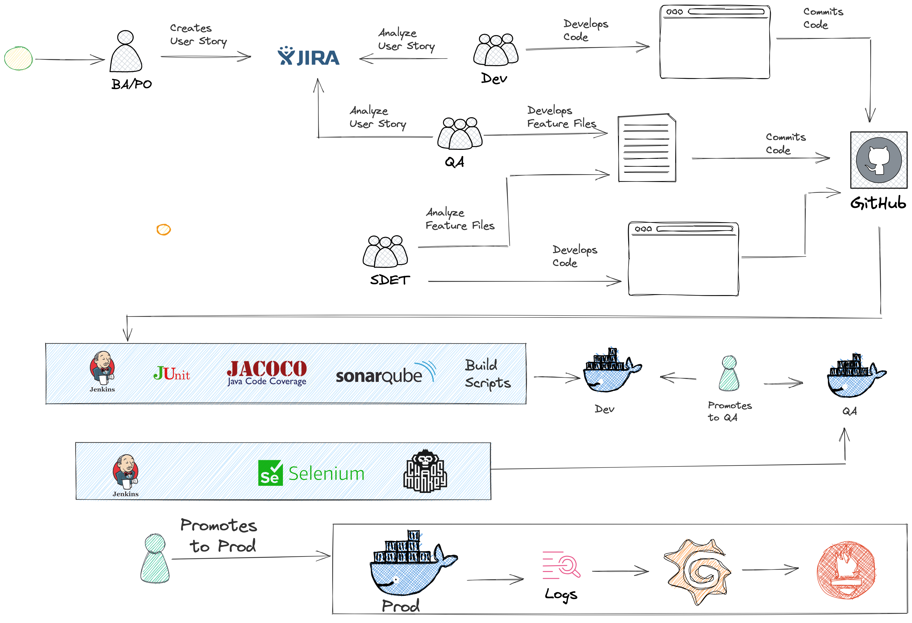
SDLC Life Cycle

Slide 17
High Level Implementation Approach
Discovery
Deployment
Solution
Approval from client Legal-compliance & Infosec Team for CORA Code GenY Deployment
Azure Open API subscription or similar LLM subscription key should already exist with the client
1-2 resources from GenY team + dedicated squad from Guidewire project team should have access ID and Environment
UseCase Approval from Project Team ( Testing )
End to end Setup Infra Setup
Plugin Installation in the VM
Implementation of the UseCase in Guidewire framework
Approval and Sign Off
Cloud Hosting (Azure) Software Installation Configuration Dry-Run Technical checkout
Test Connectivity between APIM and the LLM of AOAI
Setup CORA CODE GENY Code in the Client environment
Users and Front Door deployment and configuration + end to end user tests
Go-Live with Documentation
Current State vs Target State – Proactive solutions
Use Case 1- Synthetic Test Data Management
Use Case 2- Test Case to Automation Script
Use Case 3- Test Case to Automation Script

